Slide 1
Experiment Design: Variables
21/02/2024
Year 7 Science

Slide 2
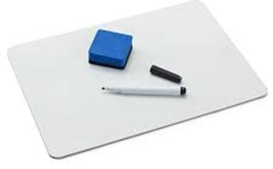

equipment
laboratory
experiment
thermometer
chemical
6. Bunsen burner
7. observation
8. inference
9. variable
10. safety

Slide 3
Learning Intentions
In fair tests, measure and control variables

Slide 4
Success criteria
Identify the independent, dependent and controlled variables in an experiment
Relate variables to table and graph layouts

Slide 5
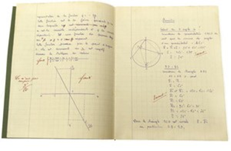
Variables
A variable is anything that can change and affect your results in an experiment.
Independent: Changed on purpose
Dependent: Measured as the result
Controlled: Kept the same for a fair test

Slide 6

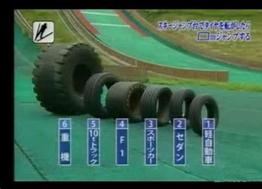
“Tire ski jump” experiment
Brainstorm all the variables
Independent?
Dependent?
Controlled?
Were they all controlled?

Slide 7
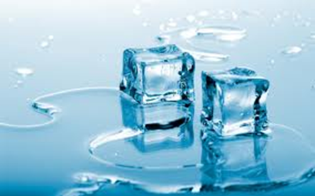
Write the variables
1. Do larger iceblocks melt slower?
IV:
DV:
CV:

Slide 8
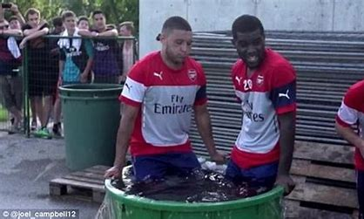
Write the variables
2. Do ice baths improve athlete’s recovery?
IV:
DV:
CV:

Slide 9
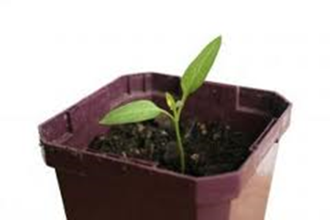
Write the variables
3. Do plants grow better in brighter light?
IV:
DV:
CV:

Slide 10
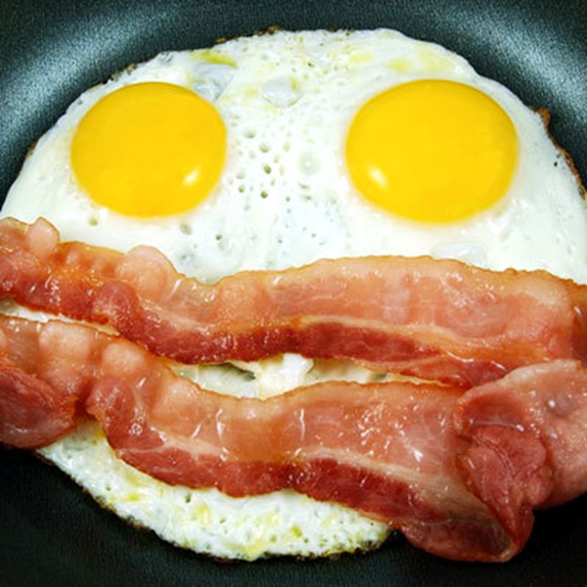
Write the variables
4. Does eating breakfast help you do better at school?
IV:
DV:
CV:

Slide 11
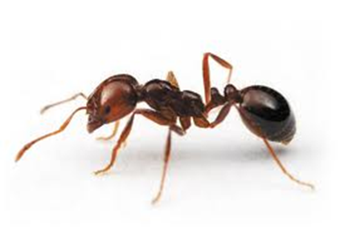
Write the variables
5. Are ants more active in hot weather?
IV:
DV:
CV:

Slide 12
Variables in tables
Independent Variable (units) eg tire | Dependent variable (units) eg distance (m)

Slide 13
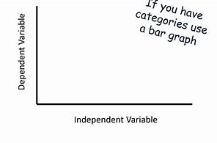
Variables in graphs
(units)
title
(units)

Slide 14
Success criteria
Identify the independent, dependent and controlled variables in an experiment
Relate variables to table and graph layouts

Slide 15
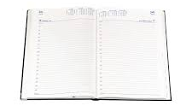
Don’t forget
Homework sheet – reading scales
Due Monday 19 Feb

